Slide 1
QAOA with TQA initialization
109550098 吳柏橙
109652020 陳怡如

Slide 2
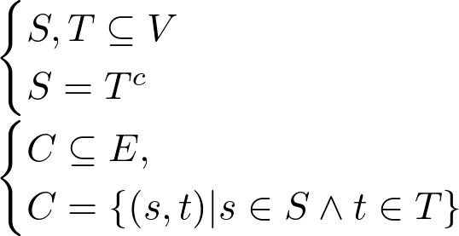
Maxcut Problem
Definition
1
What is cut?
2
What is Maxcut?
The maximum cut

Slide 3
Maxcut Problem
Why is it important?
A
NP-Complete
B
Encode
C
Classic method

Slide 4
Quantum Approximate optimization ALgorithm
Encode
0
 | 0 | 1
0 | 0 | 1
1 | 1 | 0
1

Slide 5
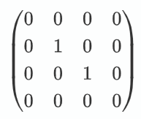
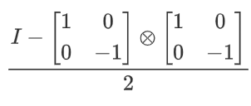

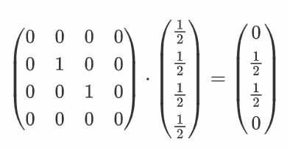
Quantum Approximate optimization ALgorithm
Encode
0
1

Slide 6


Quantum Approximate Optimization ALgorithm
1
Hamiltonian

Slide 7



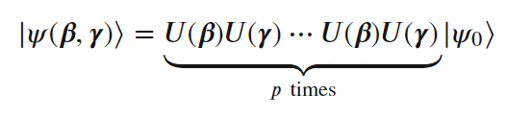

Quantum Approximate Optimization ALgorithm
QAOA circuit
1
Mixing Hamiltonian
2
Problem Hamiltonian

Slide 8
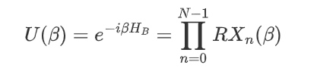
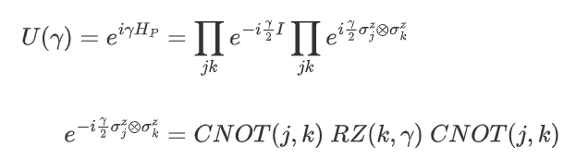
Quantum Approximate Optimization ALgorithm
1
U(β)
2
U(γ)

Slide 9
Problems of QAOA
Increasing p would lead to more complex optimization landscape
Finding a nearly optimal minimum requires exponential in p initializations
Solutions
Use solution of level p for initialization of level p+1
Reuse parameters from similar graphs
Initial state that encodes the solution of relaxed problem
Machine Learning to predict QAOA parameters

Slide 10
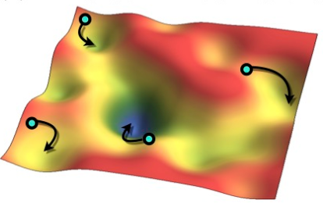
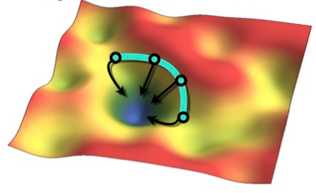
Trotterized Quantum Annealing
random init
TQA init

Slide 11
Implementation
QAOA with TQA init.
1
2
3
4
Construct QAOA
TQA initialization
Run the QAOA
Result
Construct the circuit for the graph
Define cost function
Calculate approximate cost per unit of time
Find the optimal time
Get the optimal initial value
With BFGS method as classical optimizer
Get the final γ, β
QAOA with TQA initialization has better result than random initialization

Slide 12
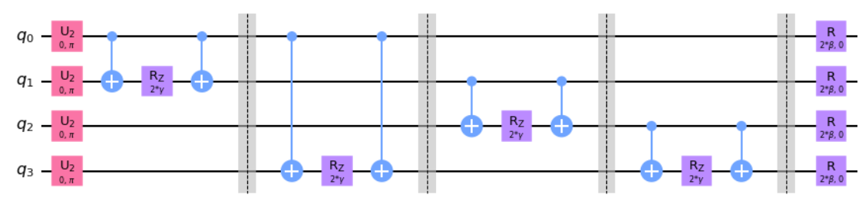

Construct QAOA
1
Construct quantum circuit for the graph
2
Define cost function

Slide 13

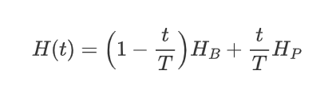

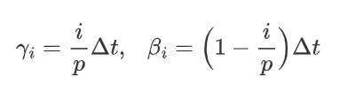

TQA Initialization
Find the optimal init. value for required p
1
Calculate approximate cost
Approximate cost per unit of time

Slide 14
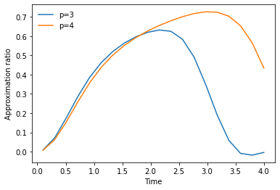
TQA Initialization
Find the optimal init. value for required p
2
Find the optimal time
About 3 for p = 4 in this case

Slide 15
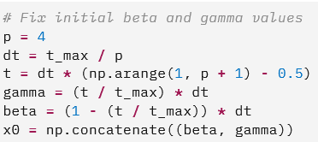
TQA Initialization
Find the optimal init. value for required p
3
Get the optimal initial value
γ, β for the optimal time

Slide 16
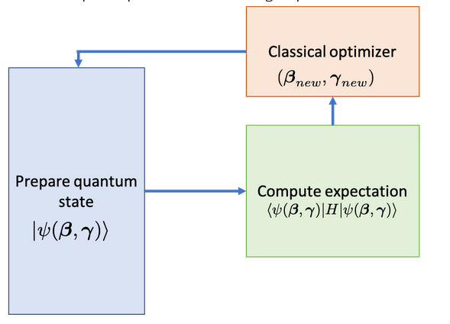
Run the QAOA
quantum approximate optimization algorithm
scipy.optimize
method='BFGS'

Slide 17
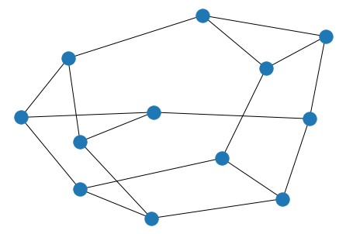
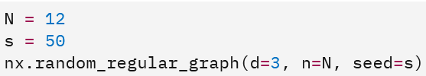
Result
TQA init
Final Approximate ratio: 0.82
random init
Final Approximate ratio: 0.75

Slide 18
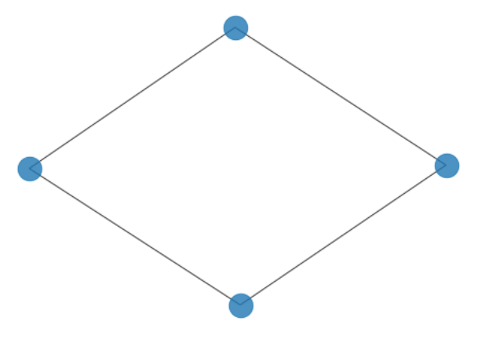
Simulate QAOA with TQA init using qiskit
1
Modify codes from qiskit textbook
2
Same method for finding init value
2
Compare random init. and TQA init.

Slide 19
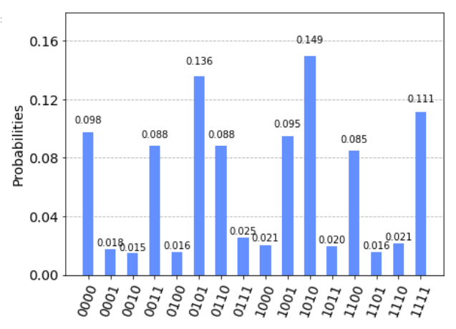
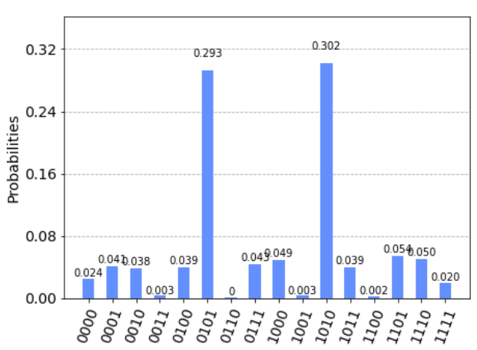
Simulate QAOA with TQA init using qiskit
random init
TQA init

Slide 20
Discussion
Limits when simulating QAOA with qiskit
Simulations use matrix multiplications
Precision loss when using method ‘BFGS’ to simulate
Hard to find suitable classical optimization method for complex graph

Slide 21
Reference
Qiskit textbook
Quantum annealing initialization of the quantum approximate optimization algorithm
量子计算与编程入门
https://slidesgo.com/theme/quantum-physics-infographics#search-quantum+physic&position-1&results-1

